Slide 1
STM32 – SPI
Dr. Enrico Conca

Slide 2
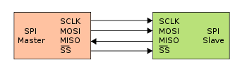
SPI
Serial Peripheral Interface
=
Synchronous serial communication interface used for short-distance communication
Full-duplex (bidirectional) communication using a single-master multi-slave architecture.
Slaves are individually selected by means of the Slave Select (SS) – also called Chip Select (CS) – line, asserted by the master. Often, these lines are active LOW, as indicated by the overbar: the line must be pulled LOW to enable the selected slave device.

Slide 3
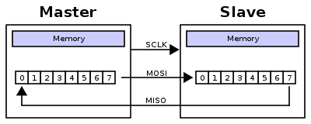
SPI - Functionality
MOSI: Master Out, Slave In
MISO: Master In, Slave Out
SCLK: Serial Clock
Transmissions normally involve two shift registers of some given word-size, such as eight bits. During each clock cycle, the master sends a bit on the MOSI line and the slave reads it. At the same time, the slave outputs a bit on the MISO line and the master reads it (“virtual ring topology”)
Data is shifted out MSB first.

Slide 4
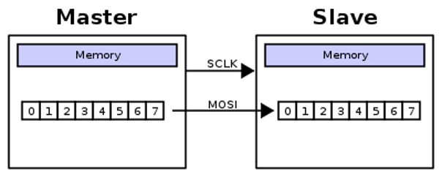
How many wires?
Often called ‘4-wires protocol’
but you don’t always need 4 wires!
…but often components have other auxilary pins, that might be syncronous to the SCLK or not. E.g. :
Reset (sync or async)
Output enable (OE)
…

Slide 5
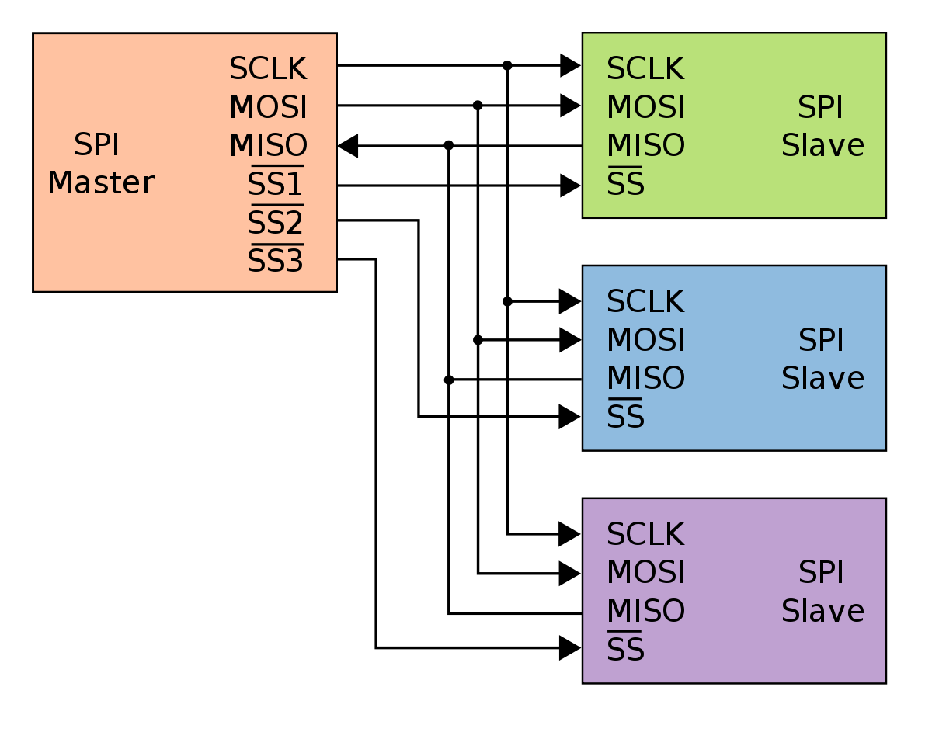
Multi-slave configurations
Independent slaves:
Every slave has an independent SS line. Requires the slave to enter a tri-state (high-impedance) mode of its MISO output when not selected.

Slide 6
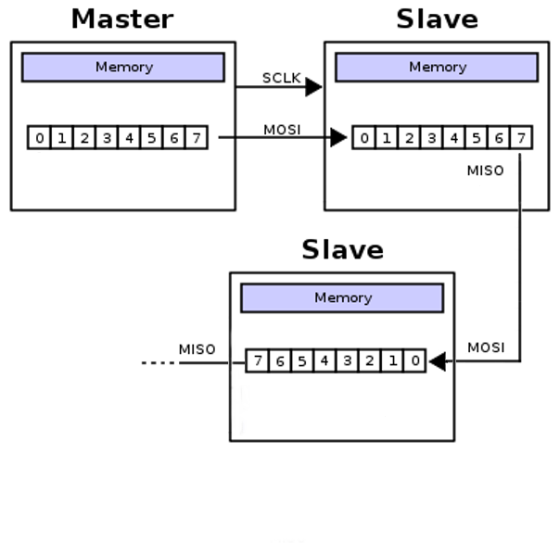

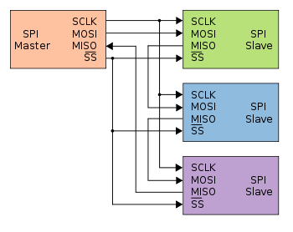
Multi-slave configurations
Independent slaves:
Every slave has an independent SS line. Requires the slave to enter a tri-state (high impedance) mode of its MISO output when not selected.
Daisy chain:
A single SS line is shared by all devices. Communication is handled like a shift register.

Slide 7
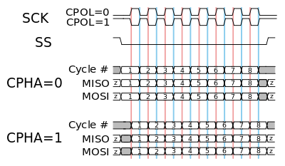
Clock POLarity & Clock PHAse
CPOL = 0 → Clock idles at ‘0’; the leading edge is a rising edge.
CPOL = 1 → Clock idles at ‘1’; the leading edge is a falling edge.
CPHA = 0 → Data changes on the trailing edge of the previous clock (i.e. is sampled on the leading edge, when its value is constant)
CPHA = 1 → Data changes on the leading edge of the current clock (i.e. is sampled on the trailing edge).

Slide 8
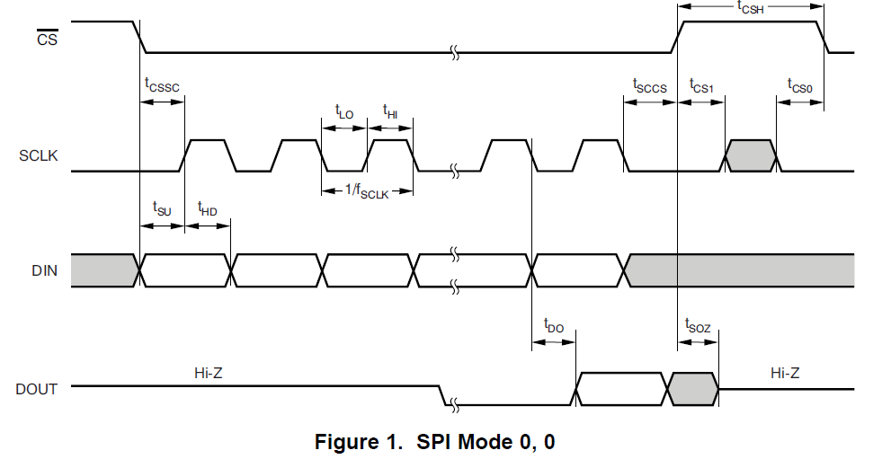
SPI mode

Slide 9
Pros and cons
Pros:
Full duplex communication
Push-pull drivers provide good signal integrity (and high speed)
Higher speed compared to I2C
Complete protocol flexibility (not limited to 8-bit words)
Very simple hardware interface
Often less circuitry, hence less power dissipated
Slaves don’t need oscillators
Very simple software implementation
Cons:
Requires more pins on IC packages than I2C
No hardware slave acknowledgment (the master could be transmitting to nowhere and not know it)
Typically supports only one master device (depends on device's hardware implementation)
Only handles short distances
Many existing variations, making it difficult to find development tools like host adapters that support those variations
:

Slide 10
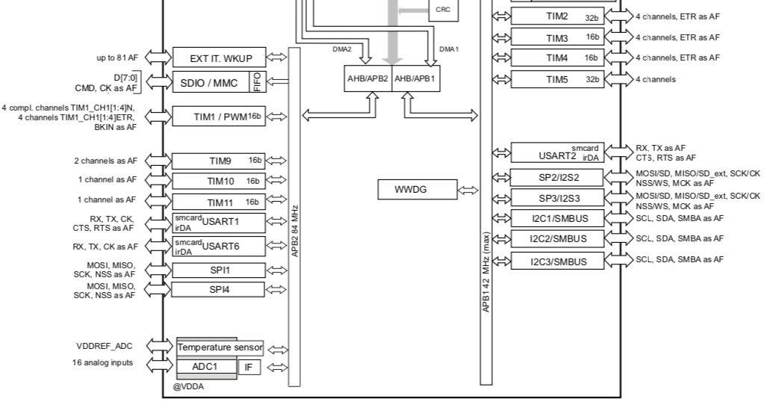
SPI – STM32F401
4 wire synchronous full-duplex communication
(up to 42Mbit/s at f_{CPU} = 84 MHz)
SPI1 and SPI4 can communicate at up to 42 Mbit/s, SPI2 and SPI3 can communicate at up to 21 Mbit/s.
The 3-bit prescaler gives 8 master mode frequencies and the frame is configurable to 8 bits or 16 bits.
All SPIs can be served by the DMA controller.
Notes:
The SPI interface can be configured to operate in TI mode for communications in master mode and slave mode.

Slide 11
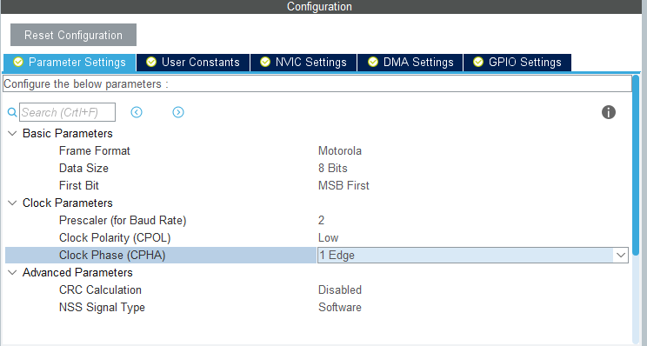
SPI configuration

Slide 12
HAL functions
HAL_StatusTypeDef HAL_SPI_Transmit (SPI_HandleTypeDef *hspi, uint8_t * pData, uint16_t Size, uint32_t Timeout)
Transmit an amount of data in blocking mode.
Parameters:
hspi: pointer to a SPI_HandleTypeDef structure that contains the configuration information for SPI module.
pData: pointer to data buffer
Size: amount of data to be sent
Timeout: timeout duration
HAL_StatusTypeDef HAL_SPI_Transmit_DMA (SPI_HandleTypeDef *hspi, uint8_t * pData, uint16_t Size)
Transmit an amount of data in non-blocking DMA mode.

Slide 13
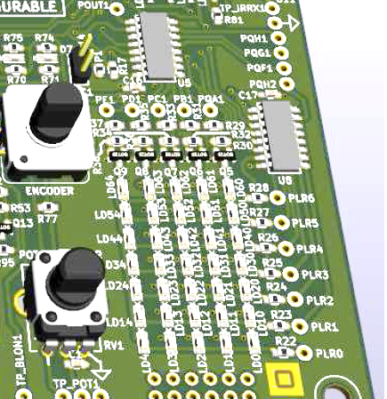
SPI – LED Matrix
Shift register
LED (7x5)
Notes:
IN QUESTA PRIMA SEZIONE CI CONCENTRAREMO SULLA MATRICE DI LED, IN PARTICOLARE SU ALCUNI ASPETTI TECNICI E SU DEGLI ESEMPI PRATICI

Slide 14
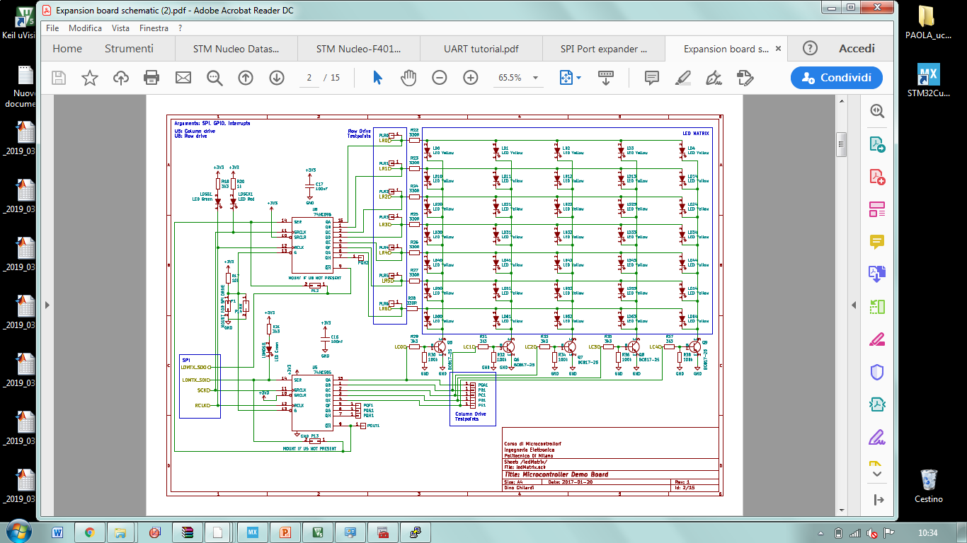
SPI – LED Matrix Overview
Row Driver
Shift Register
LED
(7x5)
Column Driver

Slide 15
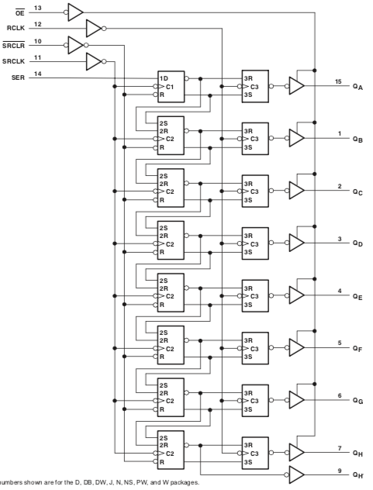
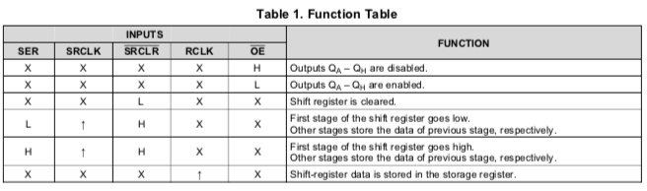
LED Matrix – Shift Register
The SNx4HC595 is part of the HC family of logic devices intended for CMOS applications.
Is an 8-bit shift register that feeds an 8-bit D-type storage register.
Both the shift register clock (SRCLK) and storage register clock (RCLK) are positive-edge triggered.
The storage register has parallel 3-state outputs. Separate clocks are provided for both the shift and storage register.
The shift register has a direct overriding clear (SRCLR) input, serial (SER) input, and serial outputs for cascading. When the output-enable (OE) input is high, the outputs are in the high-impedance state.
MISO
MOSI
Notes:
OE Output Enable
If both clocks are connected together, the shift register always is one clock pulse ahead of the storage register.

Slide 16
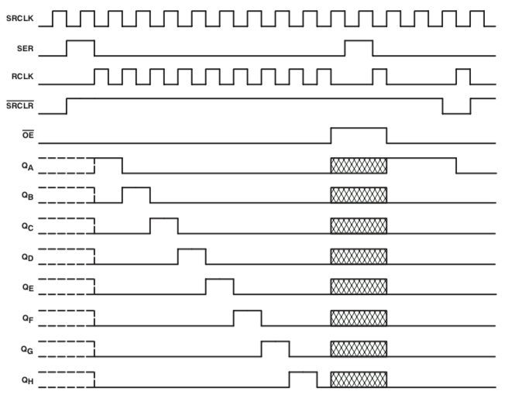
LED Matrix – Shift Register
The SNx4HC595 is part of the HC family of logic devices intended for CMOS applications.
Timing Diagram
Function Table
shift register clock (SRCLK), storage register clock (RCLK), shift register overriding clear (SRCLR), serial (SER), output-enable (OE)
Notes:
OE Output Enable
If both clocks are connected together, the shift register always is one clock pulse ahead of the storage register.

Slide 17
LED Matrix – Overview
Row Driver
Column Driver

Slide 18
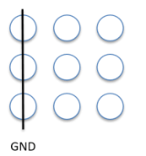
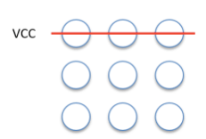
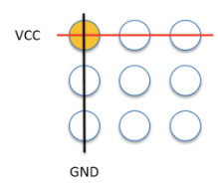
LED - Light Emitting Diode
LED Matrix Configurations
Limit the current to prevent damaging the LED
Row Driver
Transistors as voltage controlled switches
Transistor is turned on, the common cathodes of the selected column are connected to ground and the chosen LEDs light up
Current-limiting resistor
Column Driver
NPN transistors to drive the cathodes
Notes:
Produrre fotoni attraverso un fenomeno di emissione spontanea quando attraversati da una corrente elettrica.
Ponendo in serie al LED un resistore di valore appropriato, col compito di limitare la corrente che vi scorre. n questo caso la potenza in eccesso viene dissipata in calore nel resistore di limitazione collegato in serie al led.
must limit the current to prevent damaging the LED
Think of these as voltage controlled switches. When a transistor is turned on, the common cathodes of the selected column are connected to ground and the chosen LEDs light up. We need a transistor, naturally, because more than one LED in a column could be lit. In other words, we might need to sink as much as 70 mA (assuming 10 mA per LED), and the 2N2222 can easily handle that. Note, however, we must make certain that only one column is selected at a time. More about that in a moment.

Slide 19
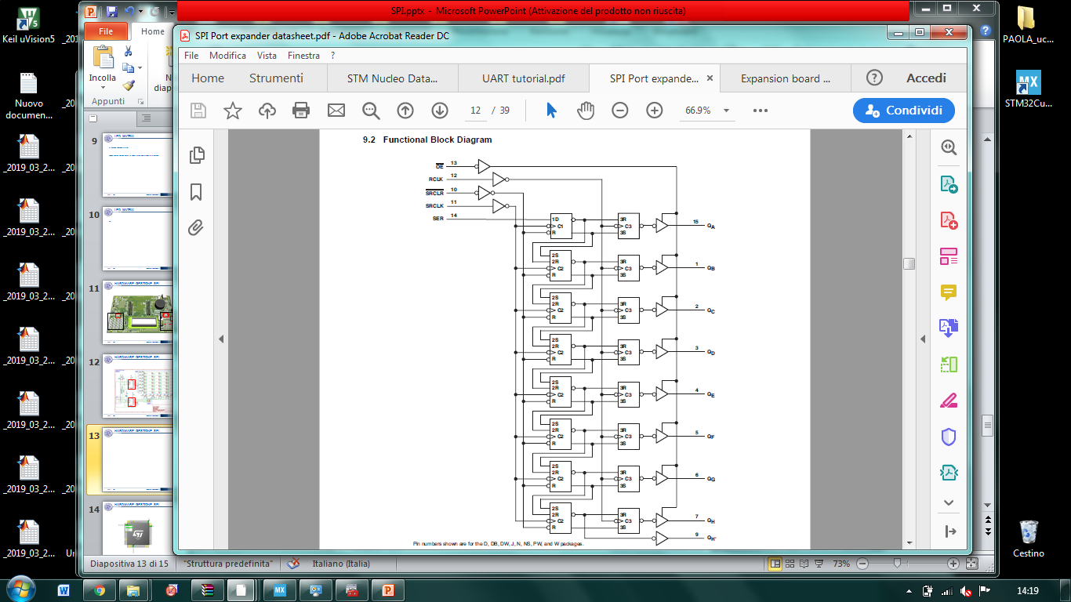
Data transfer to the led matrix(1)
OE – OUTPUT ENABLE
16 clock pulses to transfer the data to the led matrix (daisy chain configuration – Most significant bit)
ROW
SHIFT REGISTER
8 clock pulses:
Transfer the row data in the row shift register
Write the column data in the column shift register
8 clock pulses are used to write the row data in the column shift register
COLUMN
SHIFT REGISTER
For each column the correct row data are written

Slide 20
Data transfer to the led matrix(2)
1
0
0
0
1
0
MULTIPLEXING:
You can only write ONE COLUMN AT A TIME!
To show a complete matrix, quickly scan through all columns, writing one column at a time, with a fast refresh rate (> 50 Hz)
i.e. one column every < 4 ms
0
{ 68 , 16 }
0
0
0
0
1
row
column
.
.
.
.
.
16
8
4
2
1

Slide 21
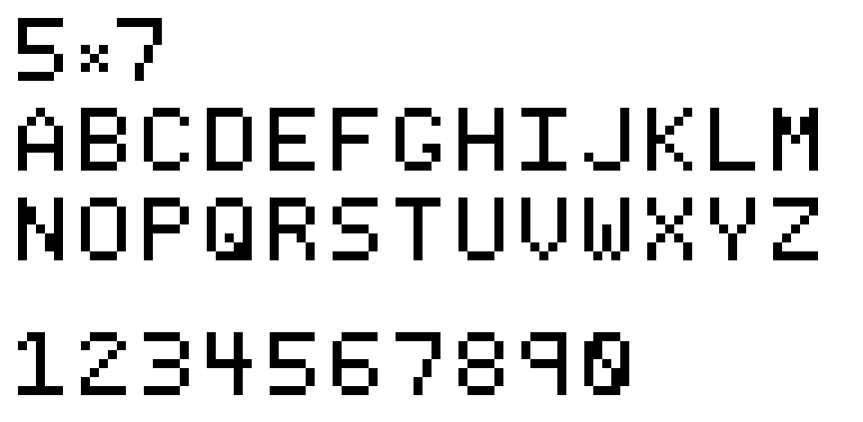
5 × 7 font example

Slide 22
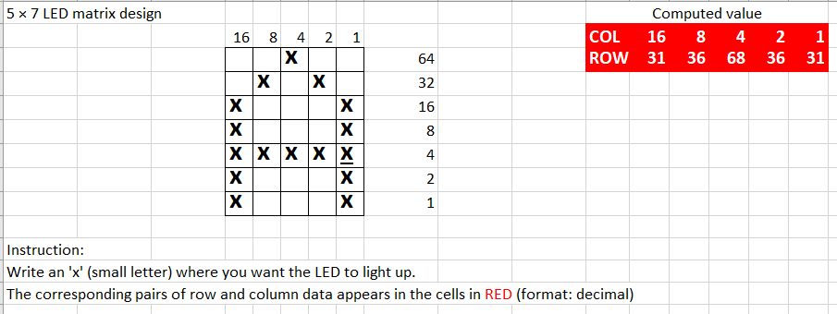
LED matrix computation
How to use the
LED matrix computation.xlsx
file

Slide 23
Project 1a – Write a single letter
Objective
Transmit a letter to the LED matrix using SPI and a timer interrupt

Slide 24
Project hints
Identify the SPI data and clock pins, as well as the RCLK of the register
Setup a timer to provide an interrupt every 4 ms. In the callback, write one column of the LED matrix and pulse the RCLK. After writing the 5th column, roll over to the first one.
Compile and debug the code.

Slide 25
Project 1b – Alternate between letters
Objective
Alternate between two letters (or one letter and one symbol)
Use the SPI DMA write and avoid the Hal_Delay function.

Slide 26
Project hints
Start from the previous project. Enable the SPI_TX DMA transfer. Beware of how the SPI DMA transfer works.
Within the main loop, find a way to change what is shown on the matrix. Keep the interrupt routine code as simple as possible.
Compile and debug the code.

